Slide 1
Digital Watchman Using Deep Learning
Team Details
1. V.Likitha (21EG505870)
2. G.Sairam (21EG505828)
3. J.Dayamani (21EG505831)
Project Supervisor
Dr. P. Ravinder Rao
Assistant Professor

Slide 2
Introduction
Security and safety is a big concern for today's modern world. In today's insecure world the video surveillance plays an important role for the security of the indoor as well as outdoor places. This hierarchical technique detects various suspicious activities such as loitering, fainting, illicit access. Then it sends an alarm message to the proper authorities. By this we can protect our society from harmful activities.
We need state of the art deep learning algorithms, fast processing, hardware, advanced CCTV cameras in real time.
Applications: Retail stores, Banks and ATMs, Airports and Transportation Hubs, Smart Cities , Schools and Campuses, and in Parking Lots.

Slide 3
Problem Statement
In Real-time there has been huge amount of fraudulent and offensive activities have been taking place. As majority of places are under CCTV surveillance, and its quite impossible by humans to be on a constant watch over the surveillance footage.
To overcome this challenge and improve efficiency, there is a growing need to automate the surveillance system with high accuracy.

Slide 4
Proposed Method
In Real-time there has been huge amount of fraudulent and offensive activities have been taking place. As majority of places are under CCTV surveillance, and its quite impossible by humans to be on a constant watch over the surveillance footage.
Additionally, it’s essential to show which frames and sections of the recording has the exceptional activity, which enables a more rapid assessment of the unusual or suspicious behavior.
In this project, we are using different Deep Learning models (CNN and LRCN), for identifying sign of violence in the real-time and performance of this Deep Learning models is also evaluated.

Slide 5
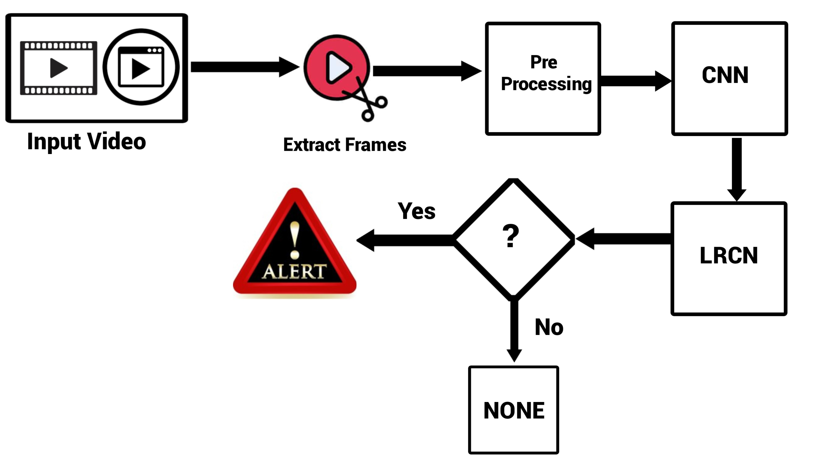
Proposed Method

Slide 6
Experiment Environment
Software Requirements:
Operating System: Windows 11
IDE: Google Colab
Libraries: Tensorflow, Keras, cv2, numpy, matplotlib, twilio,
Tensorflow & Keras: TensorFlow and Keras can be used to develop a suspicious activity detection system which uses a convolutional neural network (CNN) to extract features from images or videos, and then use those features to train a model and LRCN classifies whether the frame has any suspicious activity or not.
cv2 : OpenCV can be used to extract the frames from video to extract features from images or videos, and then use those features to train a model to classify the images or videos as suspicious or not suspicious.

Slide 7
Experiment Environment
numpy: NumPy is a fundamental library for numerical operations in Python. It's commonly used for array and matrix manipulation. In this code, it's used for various mathematical calculations and creating arrays.
matplotlib: Matplotlib is a popular library in Python for creating static, interactive visualizations and plots.
Twilio: Twilio is a cloud communications platform that enables developers to build, scale, and operate real-time communication applications. Twilio provides a wide range of APIs and services such as SMS, what’s app security personnel to notify them of suspicious activity.
Moviepy: MoviePy is a Python library for video editing, which can be used for basic operations (like cuts, concatenations, title insertions). In this project it is used to extract frames from a video, create a video of the suspicious activity that has been detected.

Slide 8
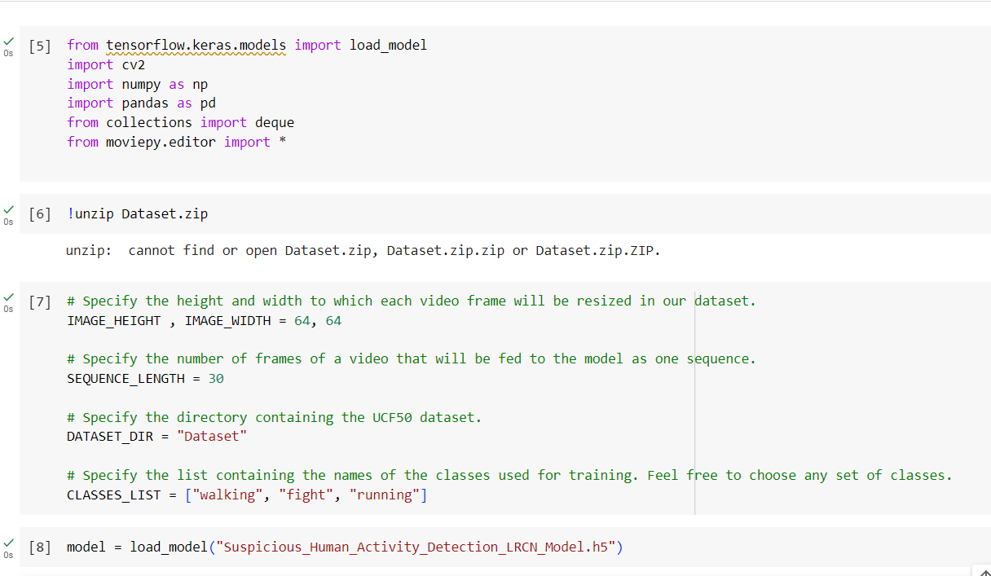
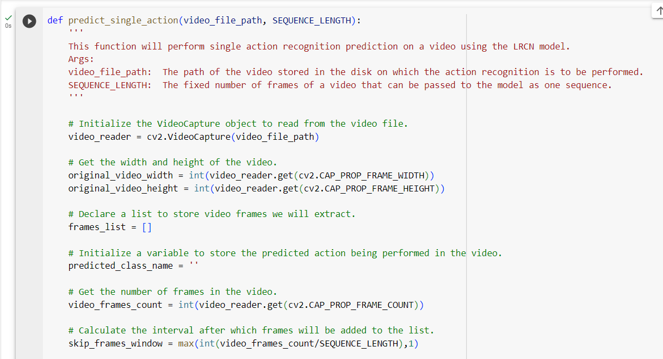
Experiment Screenshorts

Slide 9
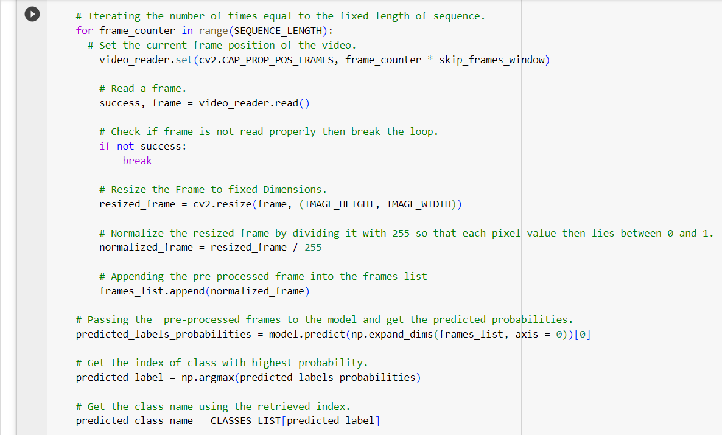
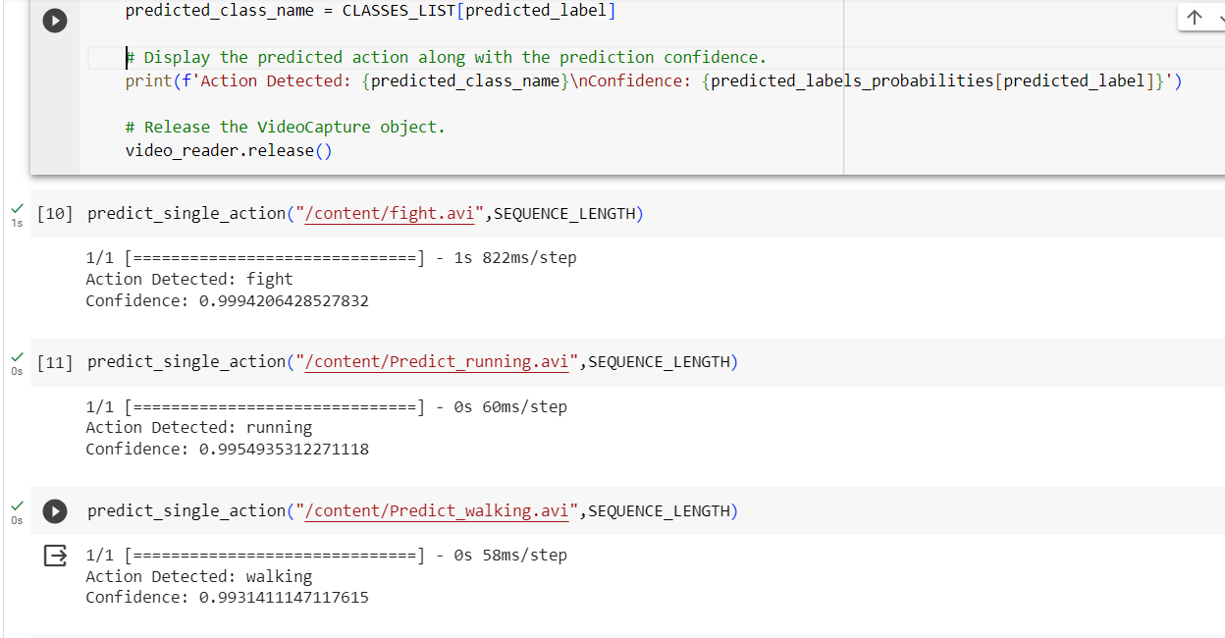
Experiment Screen shorts

Slide 10
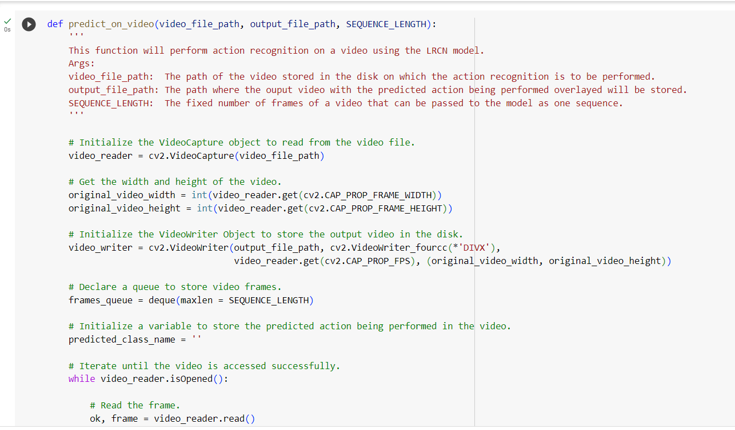
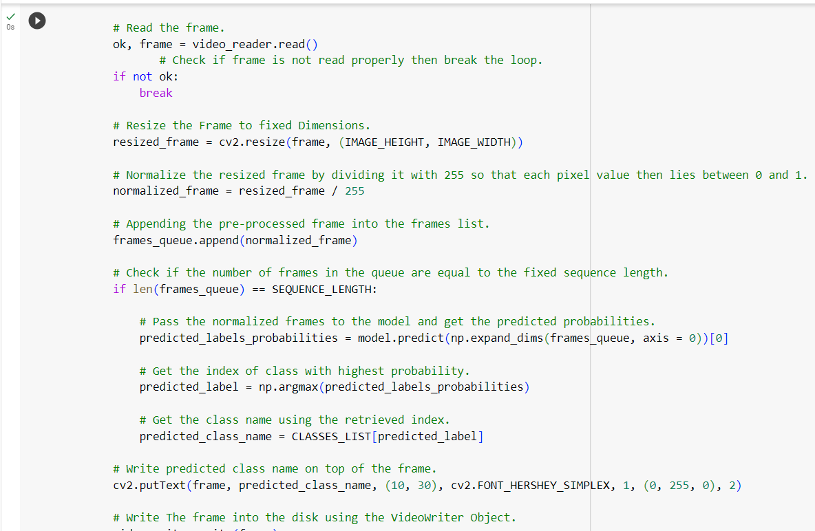
Experiment Screen shorts

Slide 11
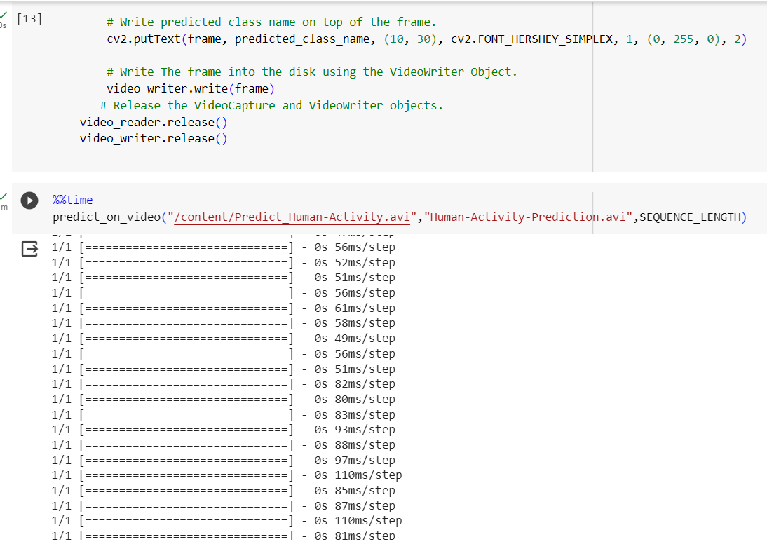
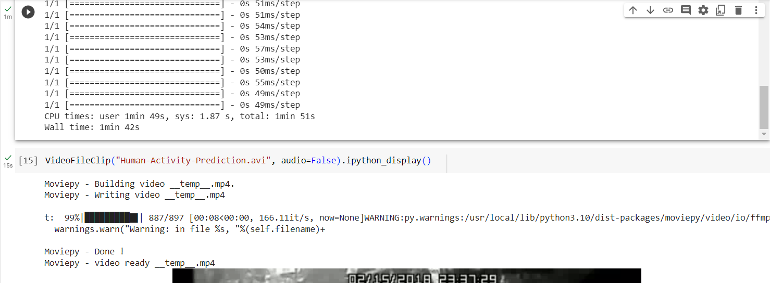
Experiment Screenshorts

Slide 12
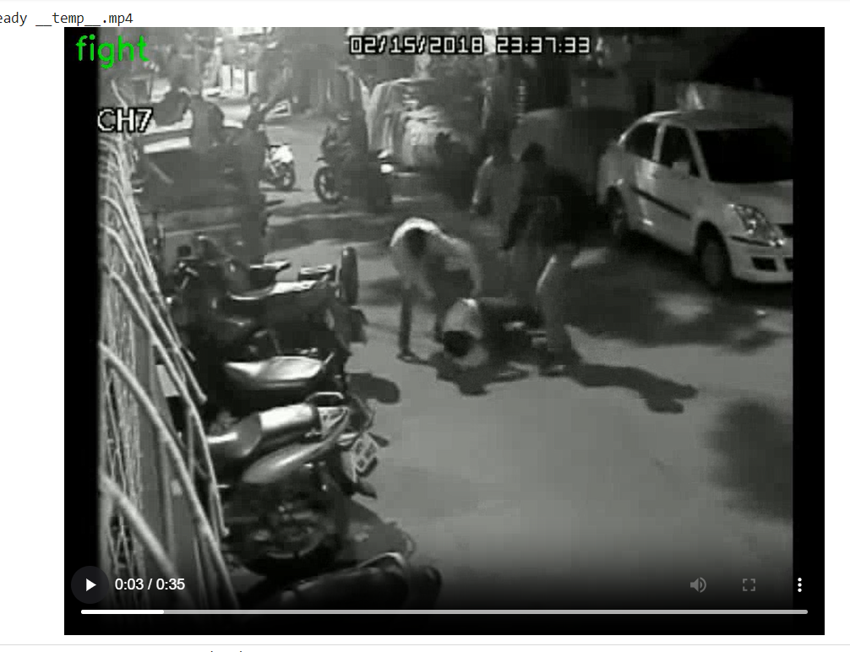
Experiment Results

Slide 13
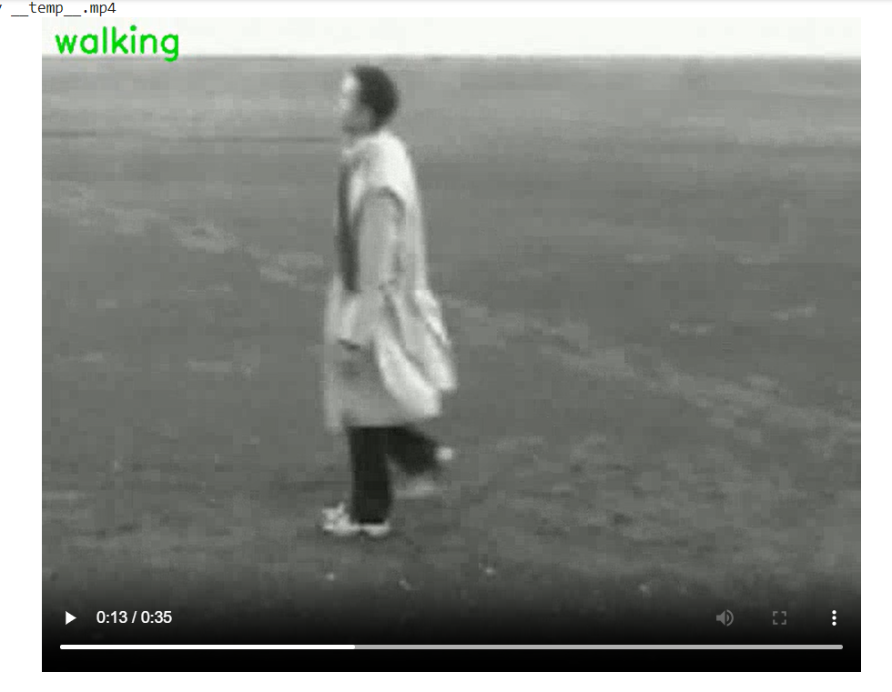
Experiment Results

Slide 14
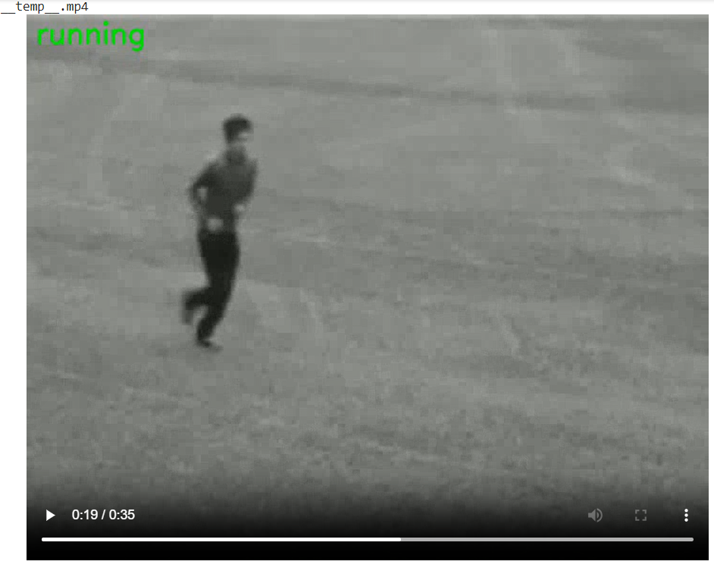
Experiment Results

Slide 15
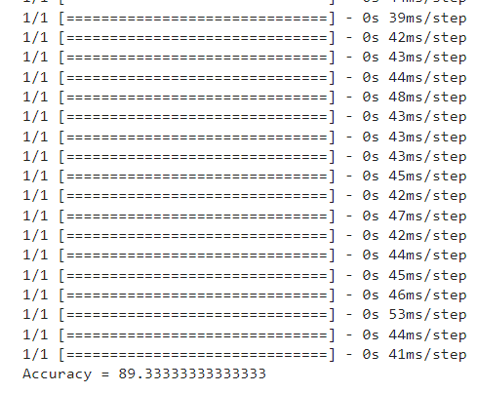
Finding
The code of this project demonstrates how to use a pre-trained LRCN model to predict actions in videos, particularly focusing on detecting suspicious activity like fighting & non suspicious activities like running, or walking with 89.3% accuracy.

Slide 16
Justification
1.What are parameters improved by your method?
Accuracy
2. Why your parameter values improved?
Improved Dataset quality

